Slide 1
Hardware implementation and Demonstration

Slide 2
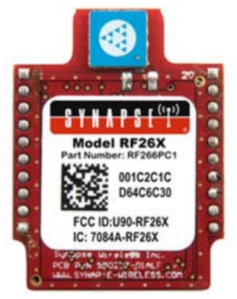
Synapse RF26X
We started off with Synapse RF26X
10-bit ADC
Up to 2 Mbps Data Rate
4K internal EEPROM
128k flash (58k free for over-the-air uploaded user apps)
ATmega128RFA1 single-chip AVR microcontroller
But Floating Points were not supported

Slide 3
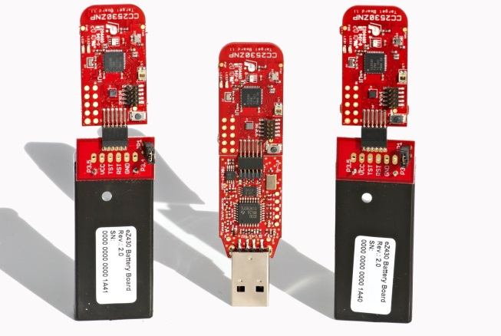
CC2530 ZDK
So we chose another module to work with that supported floating points: CC2530 ZigBee Network Processor Mini Development Kit
2.4-GHz IEEE 802.15.4 Compliant RF Transceiver
High-Performance and Low-Power 8051 Microcontroller Core
In-system programmable flash memory 32-KB
1-KB RAM
12-Bit ADC
Internal temperature sensor
Light sensor SFH 5711
Accelerometer CMA3000-D0X
Floating points supported

Slide 4
Sensor Motes
Many beginner level examples could be found on the internet regarding this module
We started learning through those simple examples and successively moved on to more complex tasks
First of all we interfaced and calibrated the on-chip sensors for: light, temperature, battery level and accelerometer
Then we wrote a simple routine that would communicate the readings from the end node to the coordinator node

Slide 5
Sensor Motes
We made a state machine that would only communicate with the coordinator node once the local event has occurred
Using this topology, we were able to reduce communication overhead and Power Consumption

Slide 6
Idle state
Network Info State
Measurements Acquisition and Outlier Detection State
Event Detection and Info Message Sending State
Default
(if something goes wrong)
ZNP Startup State

Slide 7
Limitations
Memory Constraints
Resetting of the Nodes, due to memory overflow
Small training data set
Computational Limitation
Only able to process two attributes, since no matrix operations support
Problem in Event Identification
Sensor stability
Value of luminosity fluctuates

Slide 8
Online ellipsoidal Clustering WHY?
The prime reason for selecting the online method for outlier detection was the limited memory that we had to work with
Other methods require way more memory than the online ellipsoidal clustering method
Our choice of the algorithm was correct; we successfully detected outliers
The next step was the detection of event for which we implemented our proposed algorithm presented by bilal

Slide 9
Event detection
After the detection of local events on end nodes we moved on to global event detection
For declaring global event all end nodes communicate their outliers to the coordinator node once local event has been declared
The coordinator node calculates a similarity parameter that would indicate the similarity between the outliers that caused events on different nodes: Bhattacharya coefficient
To get a more precise value of Bhattacharya coefficient (and to make a visual simulation), we interfaced the coordinator node with Matlab

